Slide 1
Use of genomic recursions in single-step genomic best linear unbiased predictor (BLUP) with a large number of genotypes
Dr. Breno Fragomeni
Assistant Professor
Animal Science - UConn

Slide 2
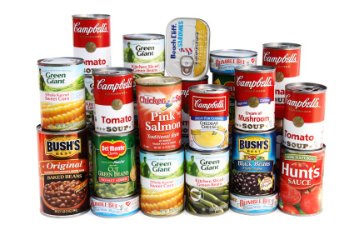

Slide 3
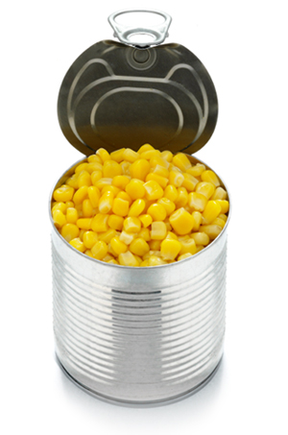
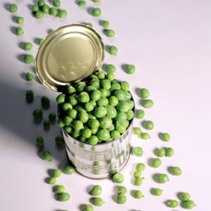
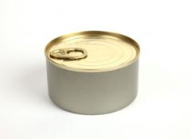
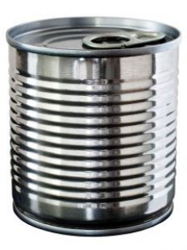
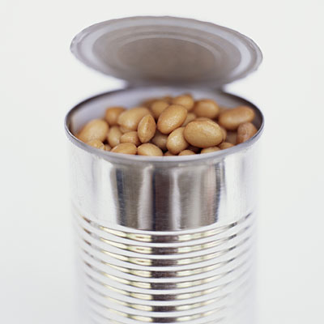
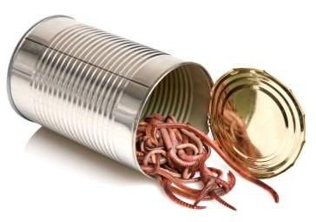
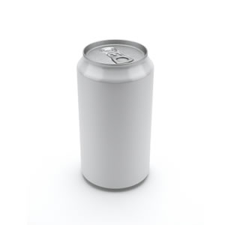

Slide 4
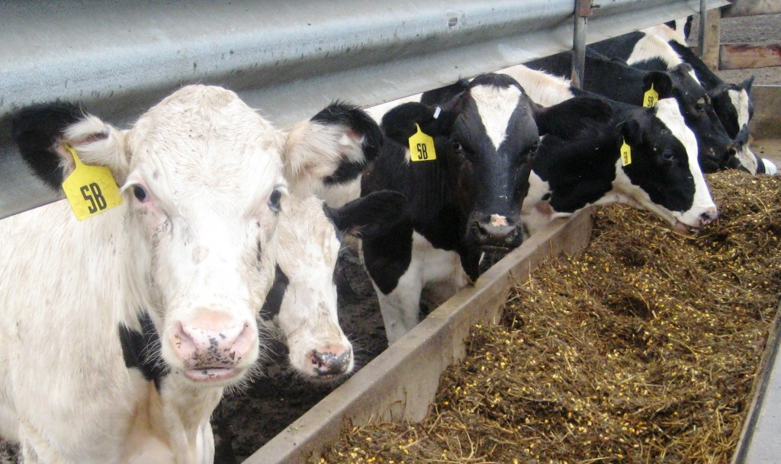
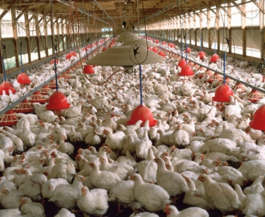
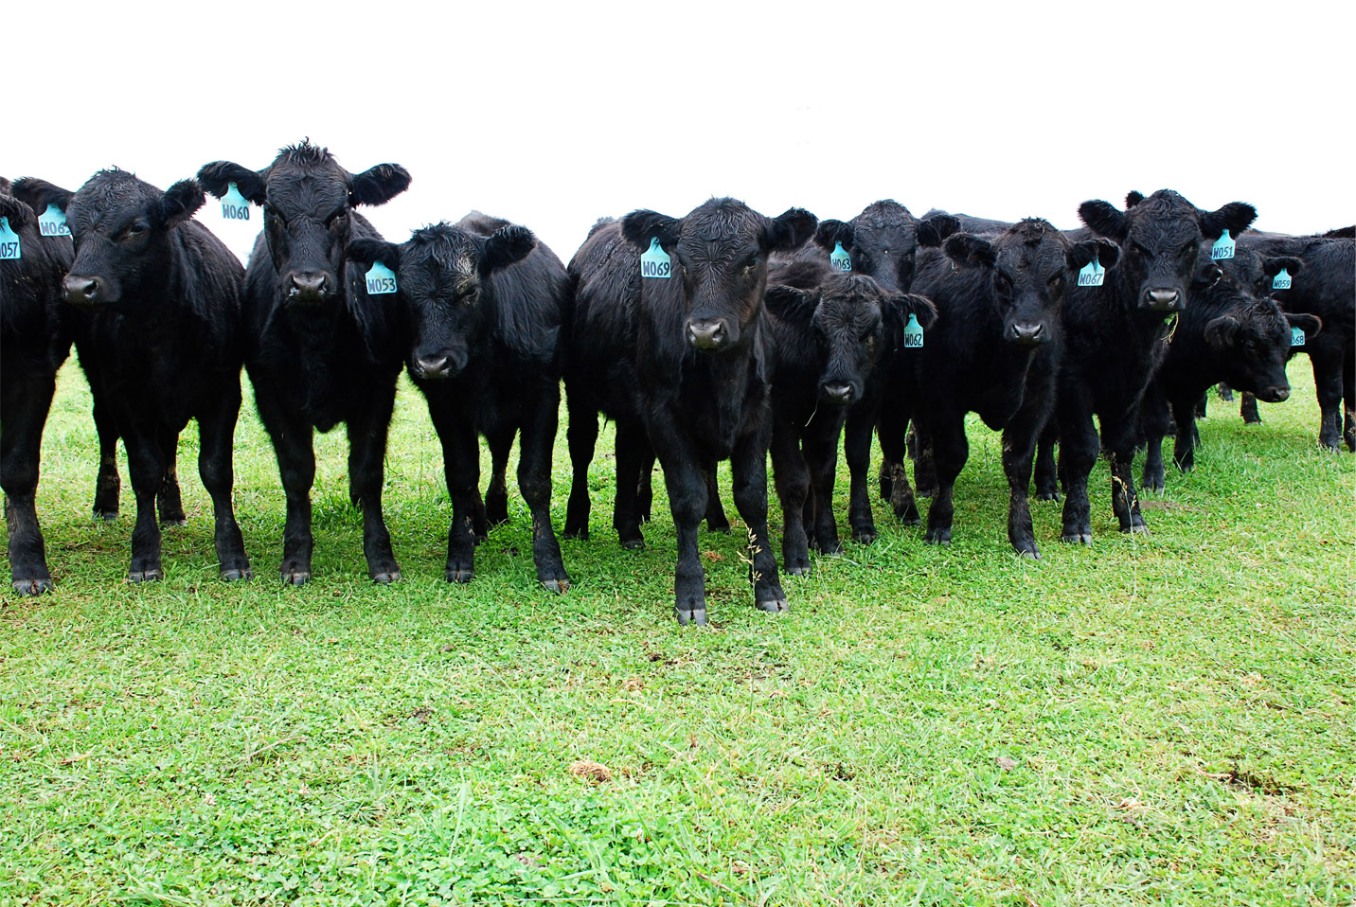
Where are the labels?

Slide 5
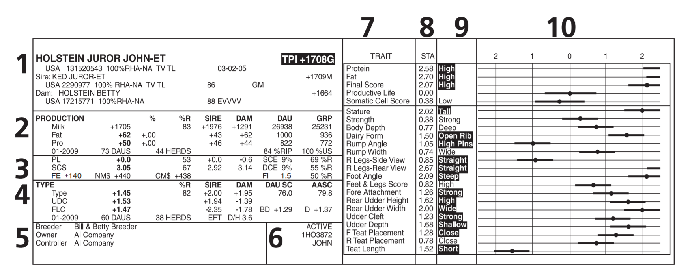
Introduction

Slide 6
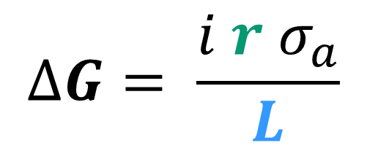
Why genomic prediction?
Selection Intensity
Genetic Standard Deviation
Genetic gain per year
Higher accuracy
    Shorter generation interval
    Higher genetic gain
Accuracy
Generation Interval

Slide 7
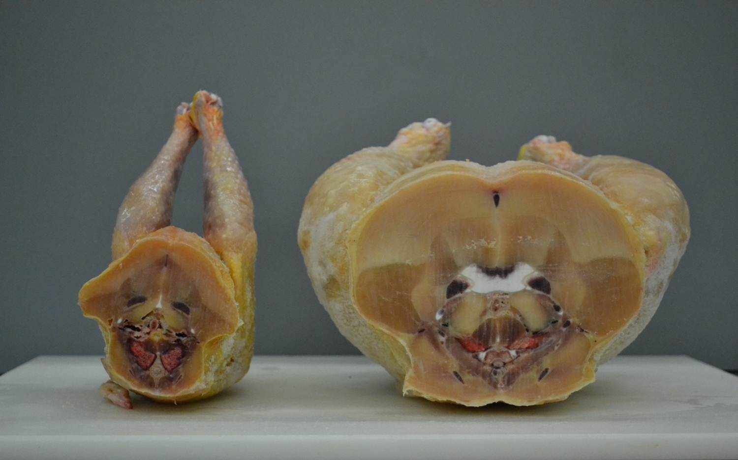
What is animal breeding?
Mating superior animals to harvest superior progeny
Phenotype=Genetics + Environment
> 50% of improvements are due to Genetics
1950’s X 2000’s Broiler Chicken
Picture: Courtesy of Dr. Nick Dale, Poultry Science, UGA

Slide 8
Dairy cattle 1940 X 2010
Production
  Increased from <5,000 to >21,000 pounds of milk per cow in lifetime
Greatly improved efficiency per unit of milk:
  23% of feed intake
  35% of water intake
  37% carbon footprint
Adapted from http://aipl.arsusda.gov/eval/summary/trend.cfm

Slide 9
Evaluation Methods
‘Phenotype based’
Mixed models (genetic)
Phenotype
Least Squares
BLUP
Genomics

Slide 10
Traditional Genetic evaluation
Pedigree
Phenotype
Model
Estimated Breeding Value(EBV)
Aims to identify superior animals with high accuracy
Progeny Testing
  High accuracy
  Slow

Slide 11

Traditional genetic evaluations
Pedigree is accounted for through an average relationship matrix (A)
Expected relationships
  Example: full siblings with no records will always have the same EBV
We need the inverse!
  Henderson rules for inversion (1976)

Slide 12
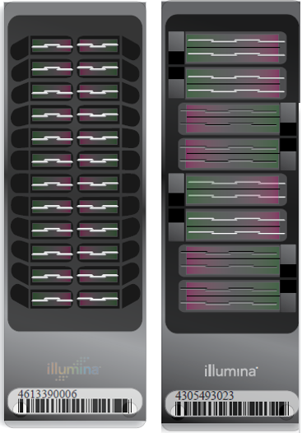
Genomic Information
Available for several animals in different species.
Single nucleotide polymorphisms – SNPs
50k markers per chip ~ $50

Slide 13
Genomic information and selection
Inclusion of DNA marker information in the analysis
Higher accuracy for young animals
  No more wait for evaluations
Genomics
Pedigree
Phenotype
Model
Genomic Breeding Value

Slide 14
Genomic Relationship matrix - dense
Realized relationship matrix (G)
  Actual relationships
Proportion of markers in common among animals
Dense matrix
  High computing cost
  Explicit inversion
  Soft limitation ~100k Genotypes
  Several Studies – no solution
Sire Dam Son Son
- SO FAR!

Slide 15
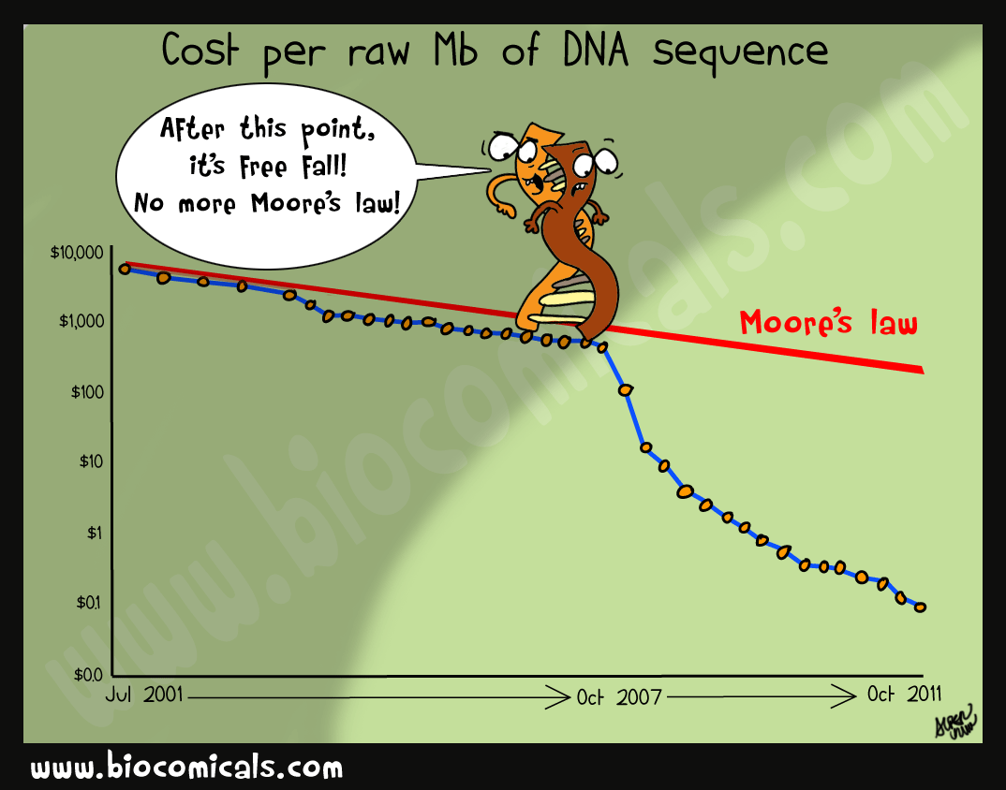
Genomic evaluation with a large number of animals

Slide 16
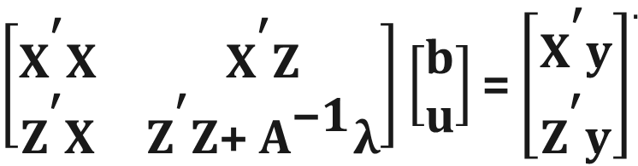
Single-Step GBLUP
H matrix: A relationship matrix that includes genotyped and ungenotyped animals
Very simple inverse
Genomic evaluation including pedigree, phenotypes and genotypes
  Genomic estimated breeding value in a single-step
Simple modification in existing software
Suitable for the same models used in traditional evaluations
H

Slide 17
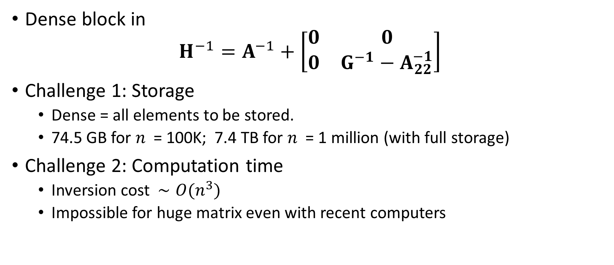
ssGBLUP Challenges
Dense block in
$$H^{−1}=A^{−1}+\left[\begin{matrix}0 & 0 \\ 0 & G^{−1}−A_{22}^{−1}\end{matrix}\right]$$
Challenge 1: Storage
  Dense = all elements to be stored.
  74.5 GB for $n$ = 100K; 7.4 TB for $n$ = 1 million (with full storage)
Challenge 2: Computation time
  Inversion cost $∼O(n^{3})$
  Impossible for huge matrix even with recent computers

Slide 18
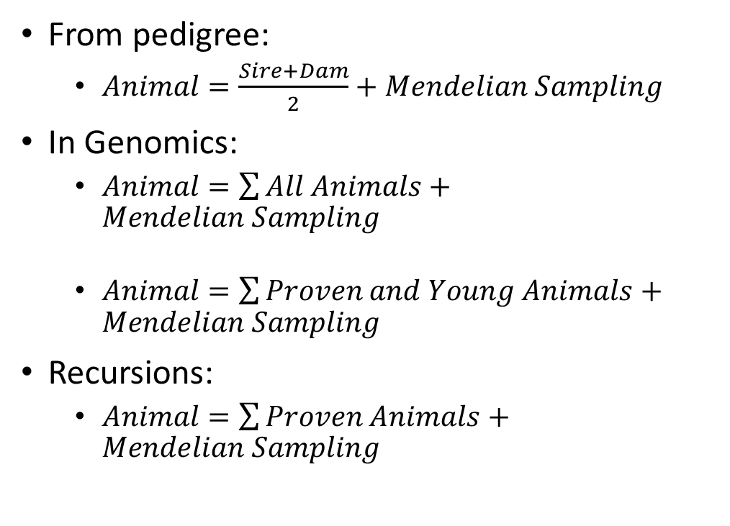
Genomic recursions for G⁻¹
Animals may contribute or not to predictions
  Hereby termed “proven” and “young” animals
Algorithm for proven and young (APY)
Population can be partitioned in two classes
  “Young” animals’ contribution to prediction can be neglected
From pedigree:
  $Animal=\frac{Sire+Dam}{2}+Mendelian Sampling$
In Genomics:
  $Animal=\sum{All Animals}+Mendelian Sampling$
  $Animal=\sum{Proven and Young Animals}+Mendelian Sampling$
Recursions:
  $Animal=\sum{Proven Animals}+Mendelian Sampling$

Slide 19

Recursions in A and G
Pedigree relationships
Genomic relationships
Genomic relationships – contributions only from proven animals
= 0 in GBLUP
$$u_{i}=\sum_{j="young"}{p_{ij}u_{j}+}\sum_{j="proven"}{p_{ij}u_{j}+}ε_{i}$$
p=proven y=young

Slide 20
Recursions in A and G
Pedigree relationships
Genomic relationships
Genomic relationships – contributions only from proven animals
p=proven y=young

Slide 21
Inverse of genomic relationship matrix
Regular G Inverse
Ignore inverse term among young animals
  Sparse G matrix
  No software limitation
Inversion only for small partition of relationship matrix
  α² less storage
  α³ less computations
APY G Inverse
α

Slide 22
Simulation Study
1.1 Million simulated animals, following dairy cattle population structure
45k markers available for genotypes animals
  25,000 genotyped animals
  7,200 genotyped sires with progeny
  12,800 genotyped young bulls without progeny
  5,000 genotyped cows with records
APY Algorithm
Scenario 1:
  7,200 sires treated as proven
  12,800 young bulls treated as young
Scenario 2:
  7,200 sires treated as proven
  12,800 young bulls treated as proven
  5,000 cows treated as young

Slide 23
Results – Scenario 01
Method | # Iterations
ssGBLUP | 226(±7)
APY | 206(±5)

Slide 24
Results - Scenario 02
Method | # Iterations
ssGBLUP | 231(±7)
APY | 209(±6)

Slide 25
Real Data
US Holstein final score (h²=0.31)
10.1M animals in pedigree file
11.4M records from ~7M cows
100k genotyped animals
  23k sires
    16k high accuracy bulls
  27k dams
  50k young

Slide 26
Real Data
ssGBLUP with regular G inverse
ssGBLUP with APY G inverse
  Treated as proven
    Sires
    Dams
    Sires + Dams
    High Accuracy sires
    Random animals
      2k, 5k, 10k, 15k, 20k – 4 samples each
Correlation between regular and apy GEBV for the 50k young animals

Slide 27
Correlations
Definition of subset | Animals in subset | Correlation | Rounds to convergence
All | 100k | 1 | 567
Sires | 23k | 0.99 | 432
Sires+cows | 50k | 0.99 | 428
Cows | 27k | 0.99 | 797
Sires > 5 progeny | 16k | 0.99 | 415

Slide 28
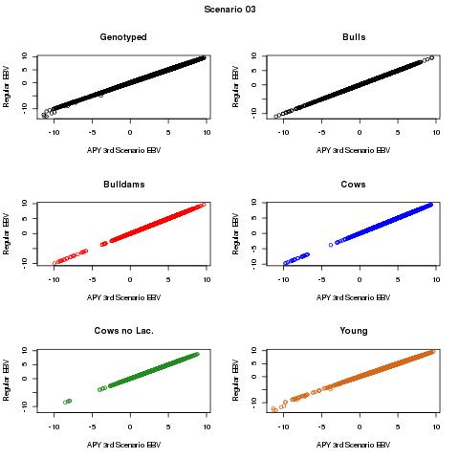

Slide 29
Correlations – Random animals in recursions

Slide 30
Implications
Academic
New understanding of genomic dimensionality
  New area of research
Interest from groups all over the world
Industry
Limitation is over: genomic selection for millions of animals
Companies and breed associations are adopting the method

Slide 31
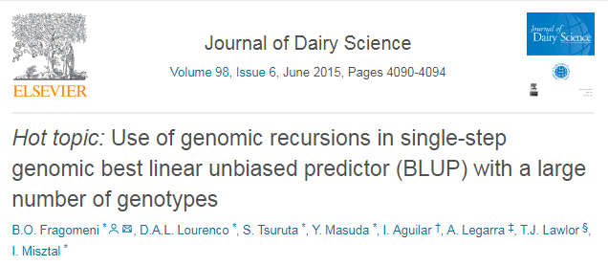
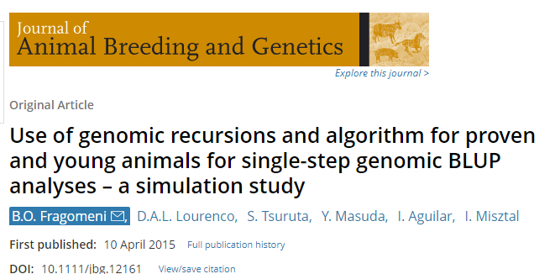
Publications

